Slide 1
Stock Market Real-Time Data Analysis Using Kafka
By Yamini

Slide 2
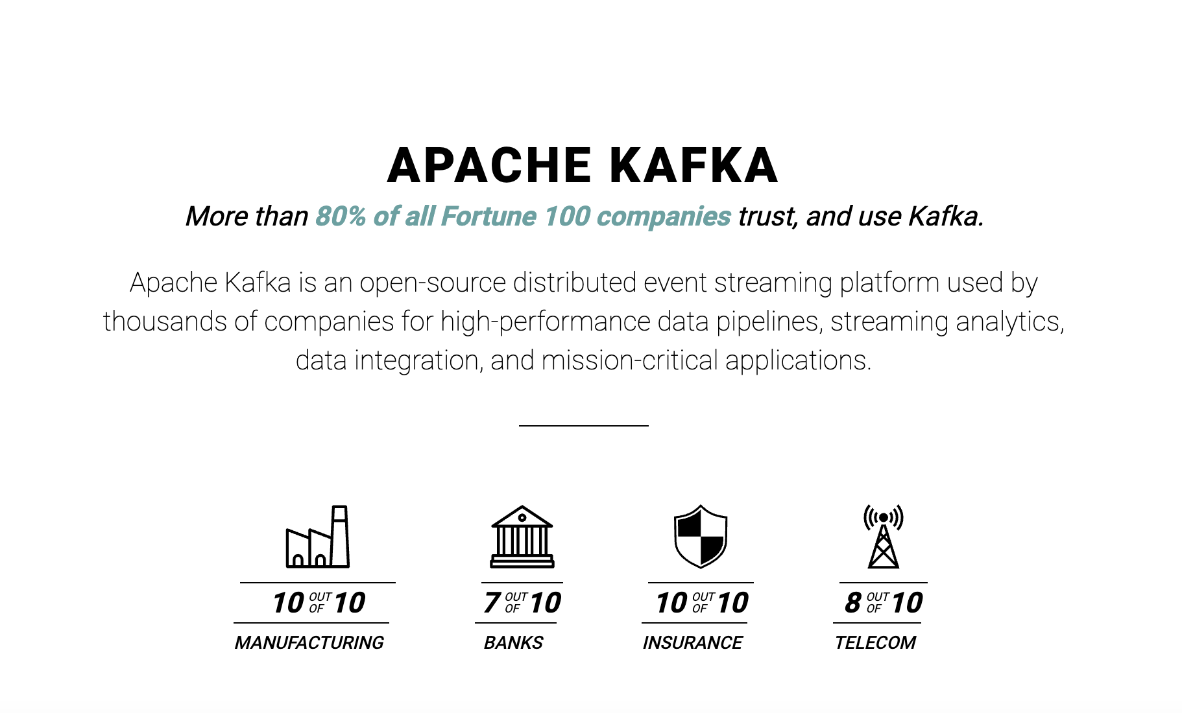
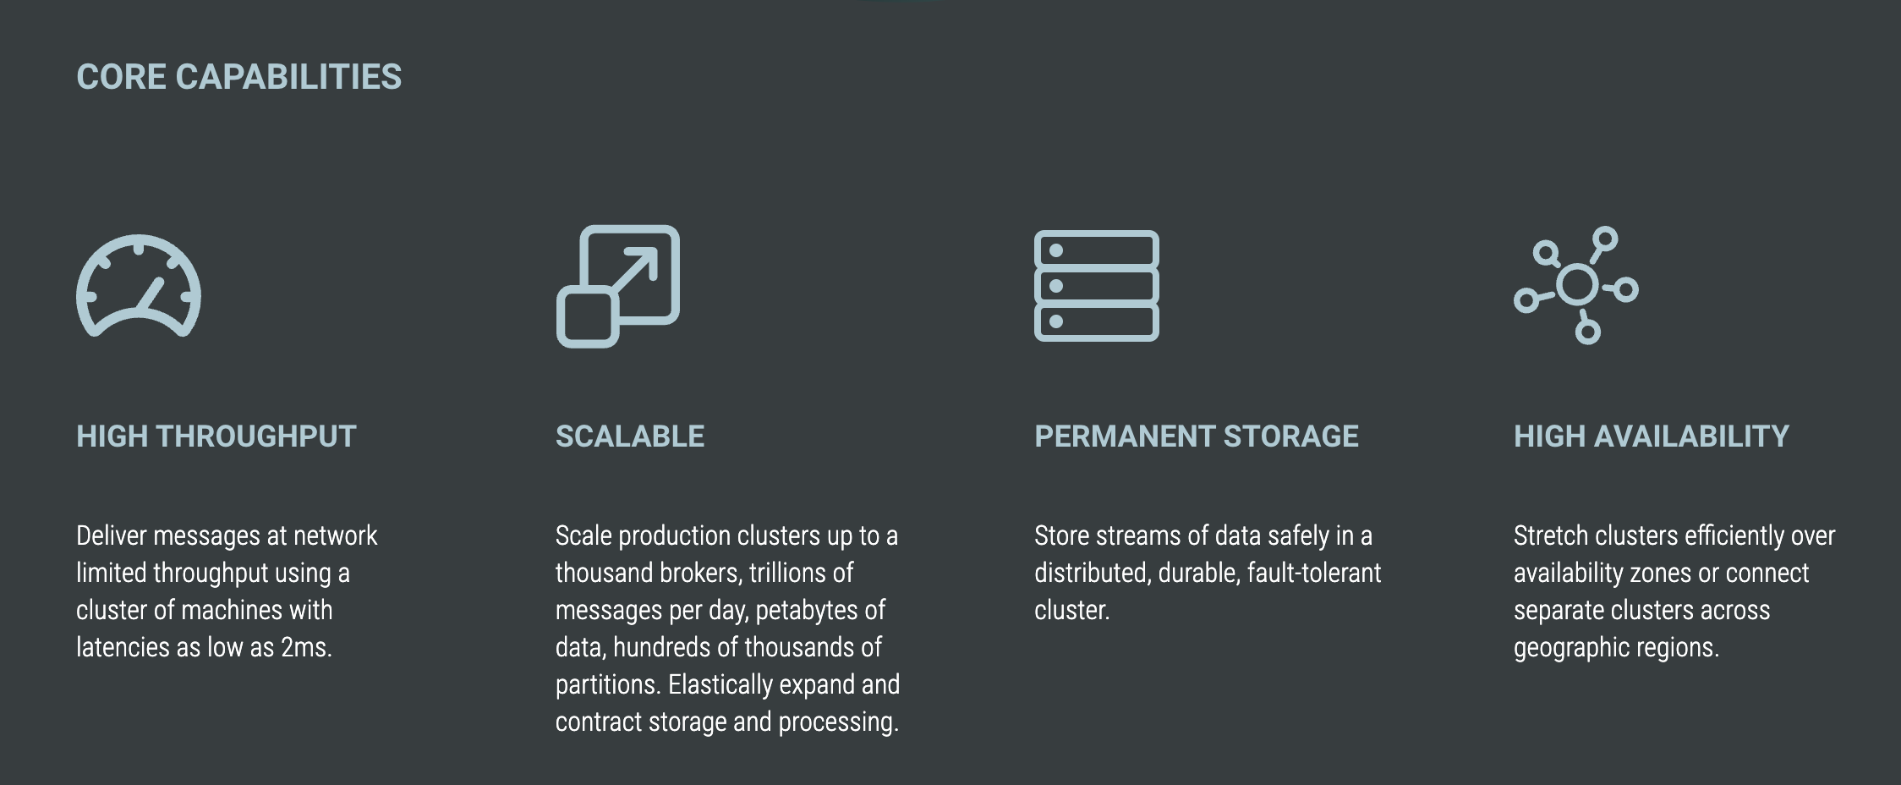
KAFKA

Slide 3



Kukatpally
Server
Ameerpet
1 Write and 2 Read operations

Slide 4
KAFKA CONCEPTS
PRODUCERS
CONSUMERS
BROKERS
ZOOKEEPER
TOPICS

Slide 5
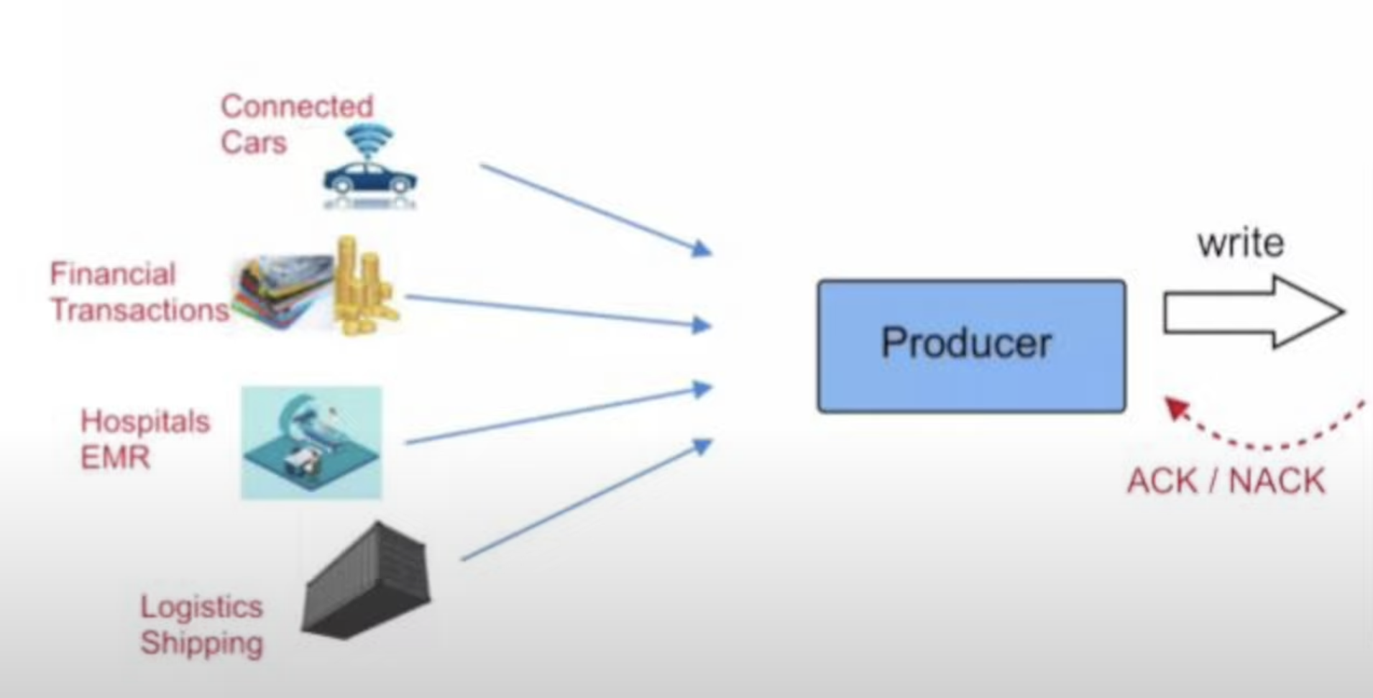

KAFKA PRODUCERS

Slide 6
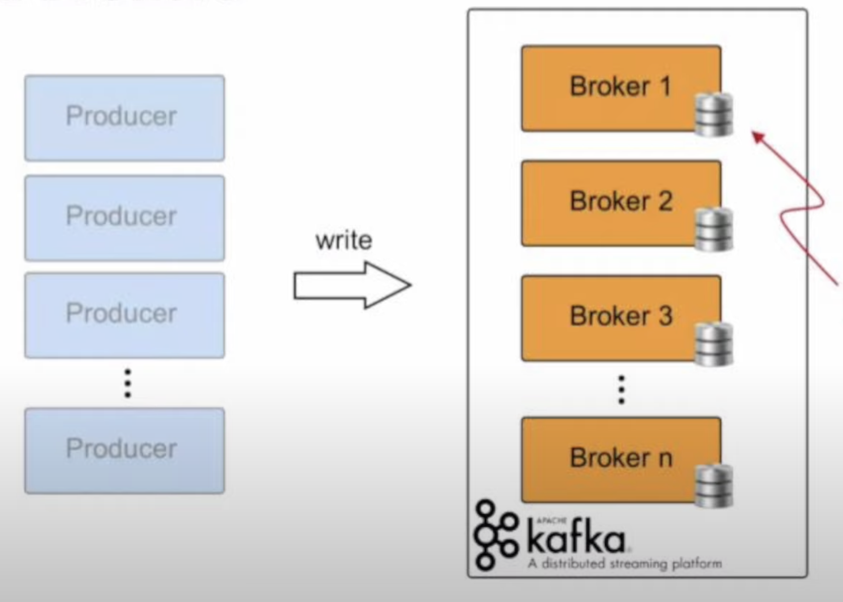
KAFKA BROKERS

Slide 7
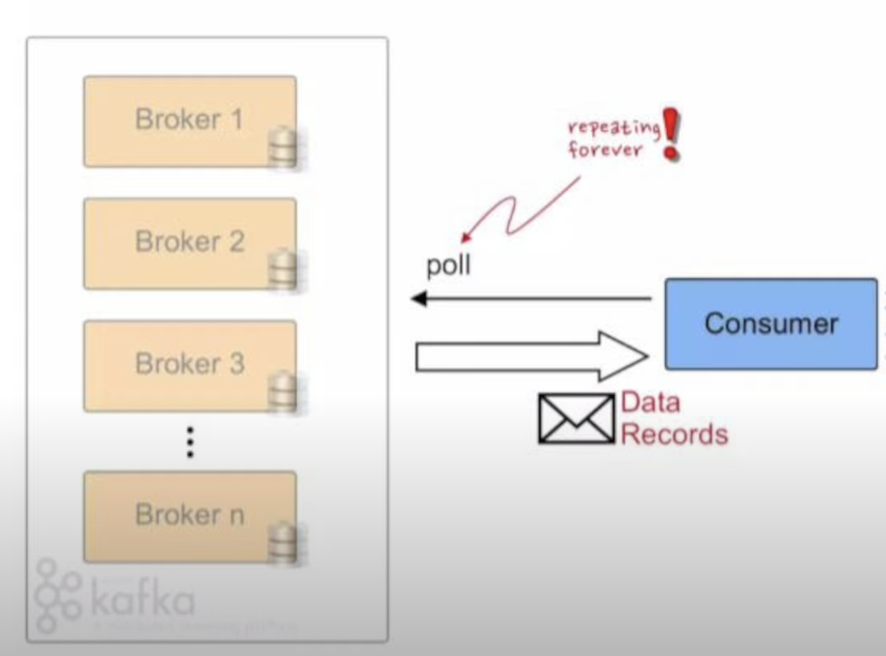
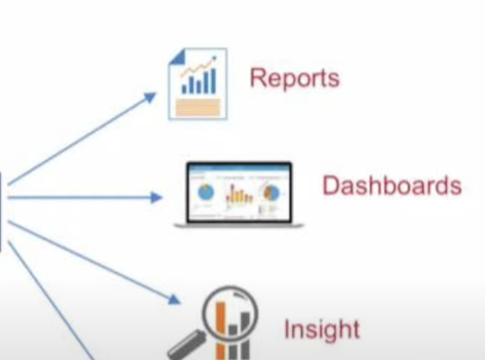
KAFKA CONSUMERS

Slide 8
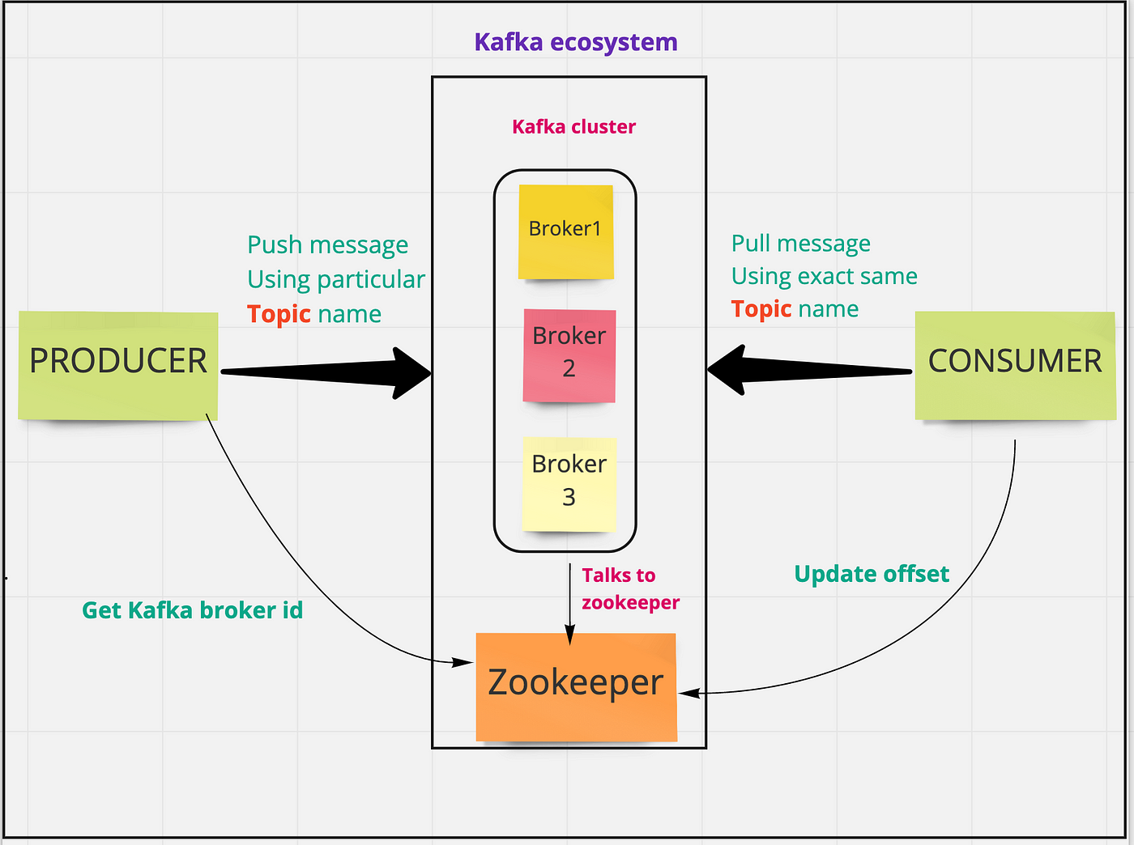

Slide 9
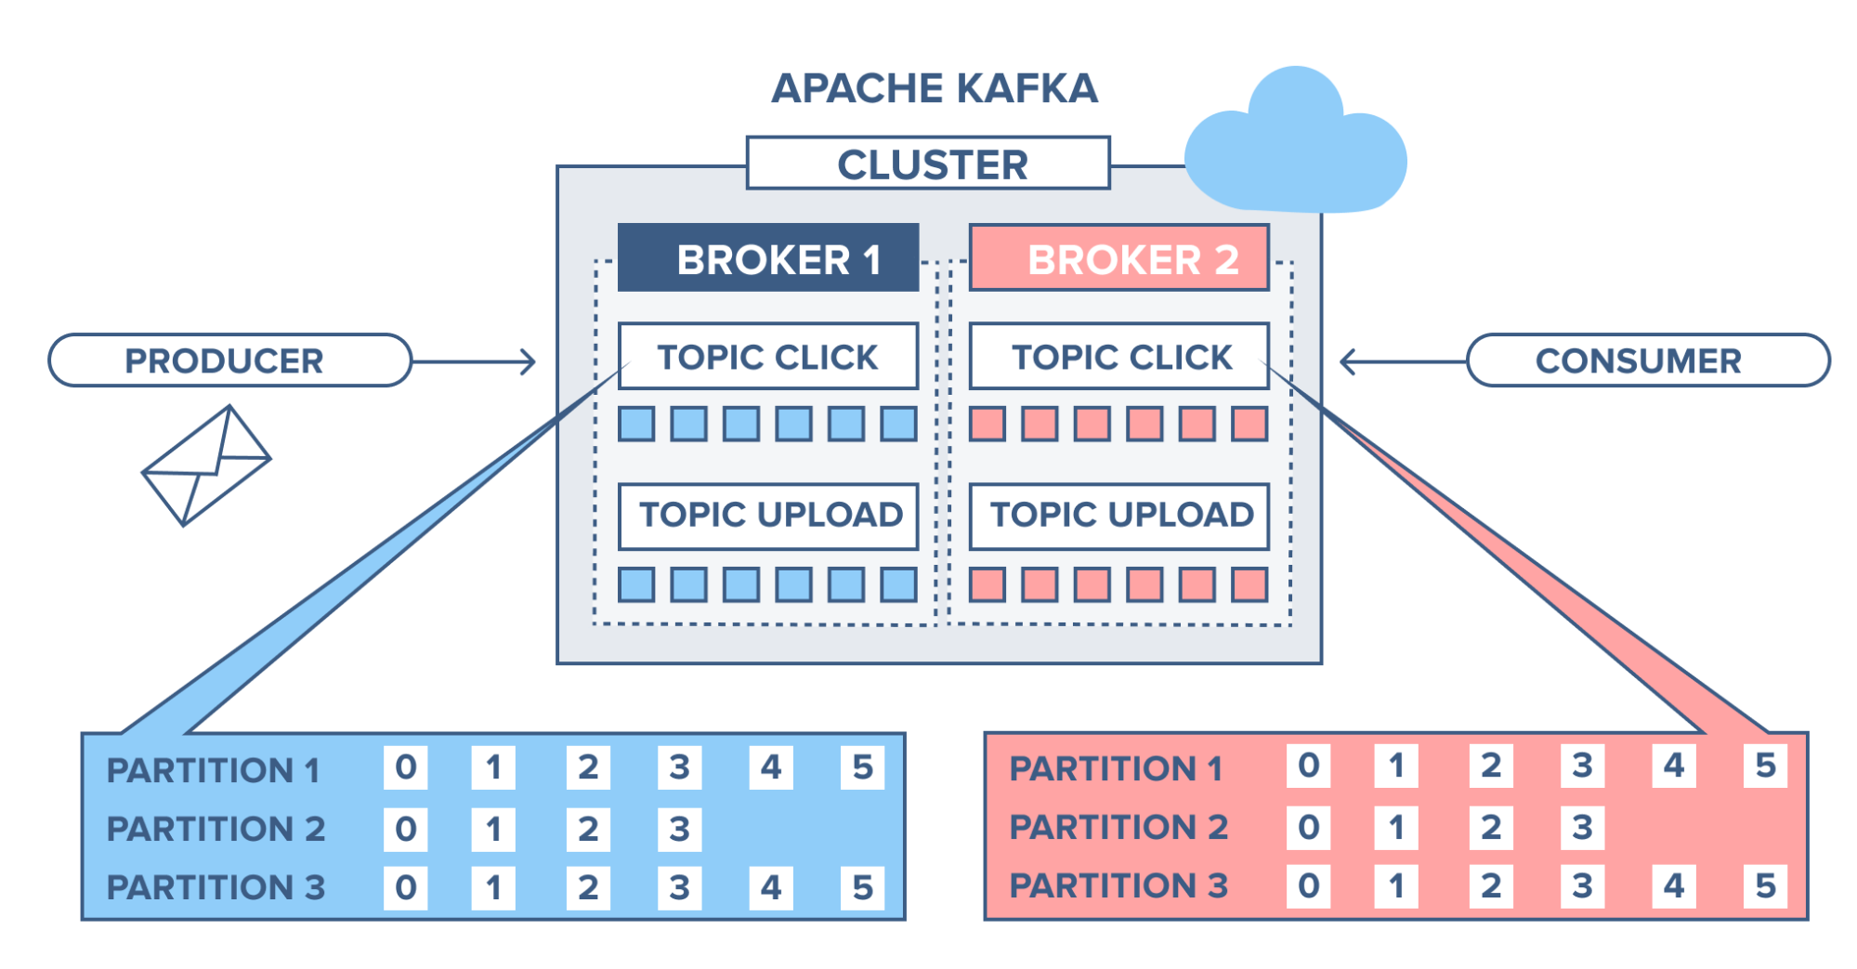
KAFKA TOPIC

Slide 10
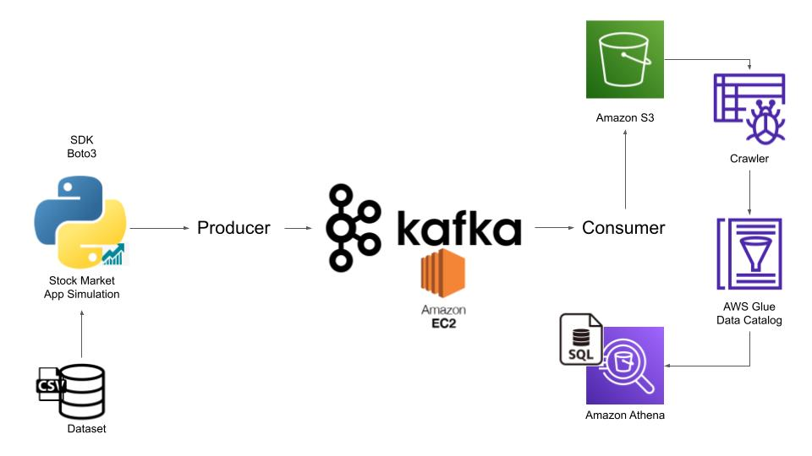
PROJECT ARCHITECTURE

Slide 11
Prerequisites OF THIS PROJECT
JUPYTER
AWS ACCOUNT
BASIC PYTHON UNDERSTANDING

